Slide 1
Web Survey System
Drop Table Team;

Slide 2
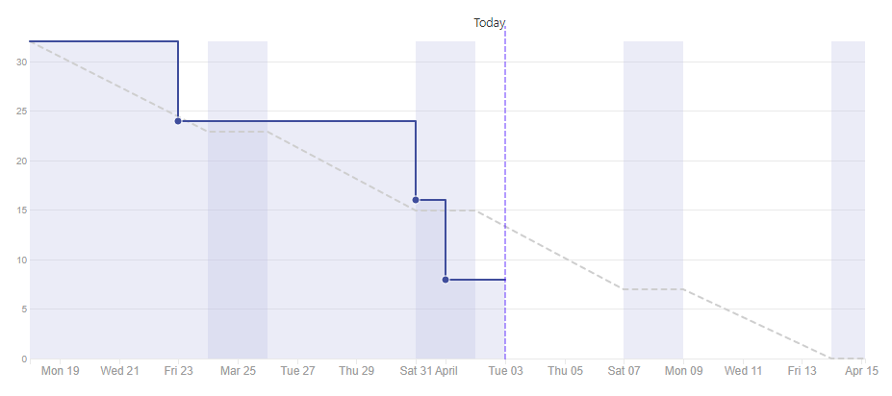
Sprint 5: Burndown Chart

Slide 3
Sprint 5: Remaining Issues
Sprint | Issue # | Item | Complexity | Complete?
5 | 16 | Generate Excel Report Tables | 3 | No
5 | 17 | Generate Excel Report Charts | 3 | No
5 | 38 | Implement Email Script | 2 | No
5 | 35 | Testing & Bug Fixing | 0 | No

Slide 4
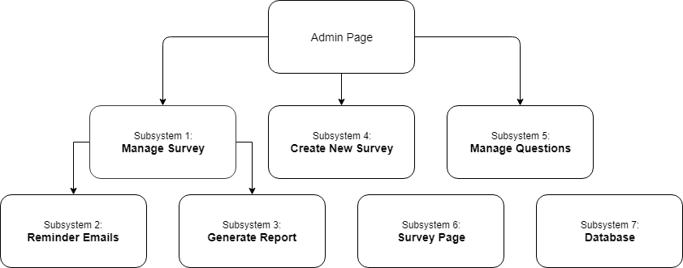
Subsystems

Slide 5
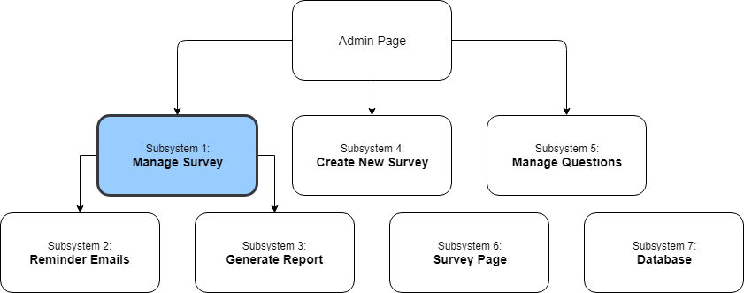
Subsystems

Slide 6
Subsystem 1: Manage Survey
Requirements:
This subsystem should allow the user modify and view each company, survey, department and participant.
Design Choices:
Company page
User should be able to:
Select
Edit
Delete
Add

Slide 7
Subsystem 1: Manage Survey
Design Choices Continue
Survey page
User should be able to:
Select
Edit
Delete
Generate a Report
Send Reminder Emails
Department
Users Should be able to:
Select
Edit
Delete
Send Reminder Emails

Slide 8
Subsystem 1: Manage Survey
Design Choices Continue
Participant
User should be able to:
Edit
Delete
Move Participant
Send Reminder Emails

Slide 9
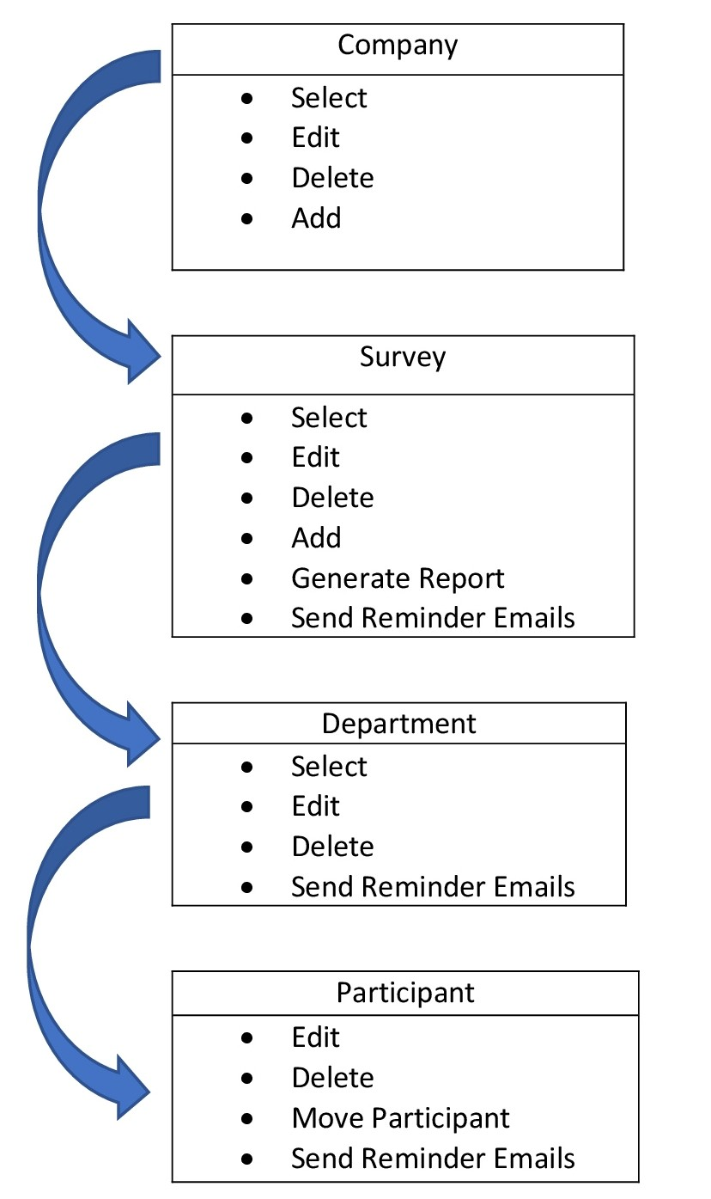
Subsystem 1: Manage Survey
Subsystem
Diagram:

Slide 10
Subsystem 1: Manage Survey
Coding:
Languages:
HTML, CSS, PHP, JavaScript
Frameworks:
jQuery, AJAX
Testing:
Making sure everything works with other subsystems
For example the report generating function with Christian’s report subsystem
Making sure all the functions work properly (edit,delete,add,etc.) and testing each individual function

Slide 11
Subsystem 1: Manage Survey
Sprint Backlog:
Sprint | Issue # | Item | Complexity | Complete?
2 | 9 | Generate Company Table | 2 | Yes
2 | 20 | Generate Survey Table | 2 | Yes
2 | 21 | Generate Department Table | 2 | Yes
2 | 22 | Generate Participant Table | 2 | Yes
2 | 32 | Generate Graphical Controls | 2 | Yes

Slide 12
Subsystem 1: Manage Survey
Sprint Backlog (Continued):
Sprint | Issue # | Item | Complexity | Complete?
3 | 23 | Implement Data Management | 3 | Yes
3 | 11 | Implement Edit View | 3 | Yes
3 | 25 | Implement Navigation | 3 | Yes
4 | 33 | Implement Report Generating | 3 | Yes

Slide 13
Subsystem 1: Manage Survey
Collaboration:
Members who collaborated
Andreas
Helped with some of the issues that I was having with editing information that is already saved and saving that to the database
Helped with some of the issues that I was having with saving new information to the database
Helped with the navigation between pages

Slide 14
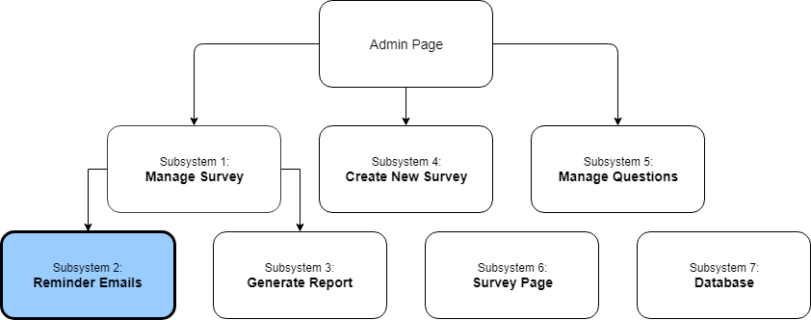
Subsystems

Slide 15
Subsystem 2: Reminder emails
Requirements:
The subsystem should send reminder emails to participants who have not yet submitted.
The subsystem should be able to send reminder emails on a survey-wide, department-wide, and individual participant level.
Design Choices:
Subsystem takes in data via AJAX (POST to server).
Emails are sent out from: do-not-reply@domain.com
The user can specify the email script in an HTML document.
Default email script is provided.

Slide 16
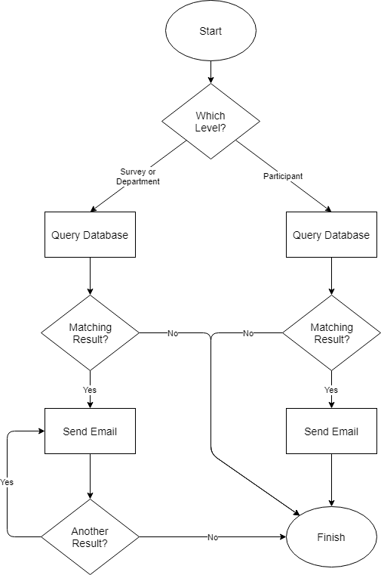
Subsystem 2: Reminder emails
Data Flow Diagram:

Slide 17
Subsystem 2: Reminder emails
Coding:
Languages:
PHP - Server-side language used to query the database and send out automated emails.
Testing:
Functional Testing:
Ensure that emails are generated at each level.
Ensure that emails are only generated for non-submitting participants.
Ensure that emails aren’t caught in spam filter.
Ensure that emails contain working links.
System Testing:
Ensure that the subsystem functions on various platforms:
Chrome, Firefox, Edge (IE not supported)

Slide 18
Subsystem 2: Reminder emails
Sprint Backlog:
Sprint | Issue # | Item | Complexity | Complete?
5 | 38 | Implement Email Script | 2 | No
5 | 39 | Implement Reminder Email Generating | 3 | Yes

Slide 19
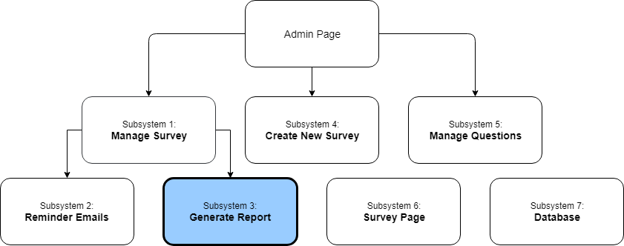
Subsystems

Slide 20
Subsystem 3: Generate report
Requirements:
Administrative
Reports can be generated from survey responses
Both in downloadable excel format and web-based format.
Design Choices:
Choosing to use external libraries as opposed to coding a solution from scratch (time saved).
Choosing PHPSpreadsheet over other excel writing PHP libraries, as it is the most well-developed one and is compatible with the client’s web host.
Choosing CanvasJS for displaying graphs in the web-page, since it is JavaScript based and works with our website architecture.
Having a separate spreadsheet for each department included in the survey (for readability and navigability).
Using per-question answer average to show meaningful at-a-glance results.
Building the spreadsheet anytime the admin clicks Generate Report, then offering a download to them, as opposed to saving the spreadsheet on the server (more flexible and saves server space).

Slide 21
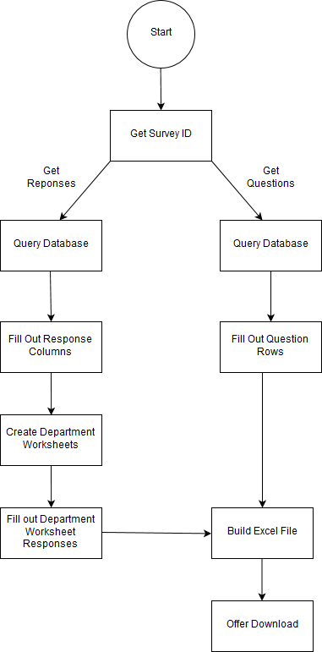
Subsystem 3: Generate report
Generate Excel Report Diagram:

Slide 22
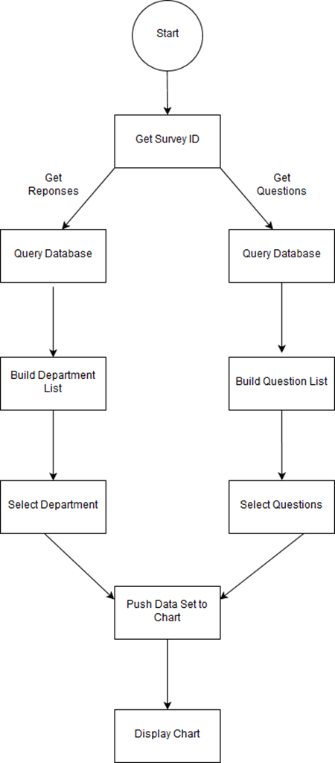
Subsystem 3: Generate report
Generate Web Report Diagram:

Slide 23
Subsystem 3: Generate report
Coding:
Approach: Functional, Object-Oriented
Language: HTML5, Javascript, PHP
Testing:
Compatibility
Does subsystem work correctly under various browser types?
What will need to be done to preserve subsystem integrity if a browser does not support its functions?
Ensure that excel file offered is supported by a variety of Excel versions.
Functionality
Does subsystem work as intended?
Does subsystem work under a wide variety of conditions (many questions, many participants, many departments, etc)?

Slide 24
Subsystem 3: Generate report
Sprint Backlog:
Sprint | Issue # | Item | Complexity | Complete?
5 | 16 | Generate Excel Report Tables | 3 | No
5 | 17 | Generate Excel Report Charts | 3 | No

Slide 25
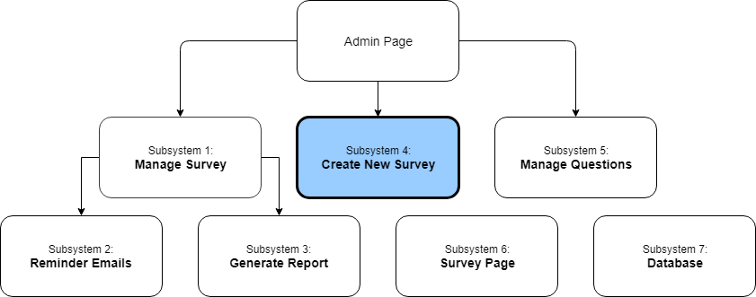
Subsystems

Slide 26
Subsystem 4: create new Survey
Requirements:
The subsystem should facilitate creating new surveys.
User should be able to specify:
Company
Start & End Date
Departments List:
Department Name
Emails
Questions

Slide 27
Subsystem 4: create new Survey
Design Choices:
Subsystem is broken into two components:
createsurvey.php: handles the page layout and operations available to the client.
submitsurvey.php: handles submitting the survey parameters to the database.
Arrays used to mimic data binding when selecting item in list.
Left question list is strictly sorted; right question list is not.

Slide 28
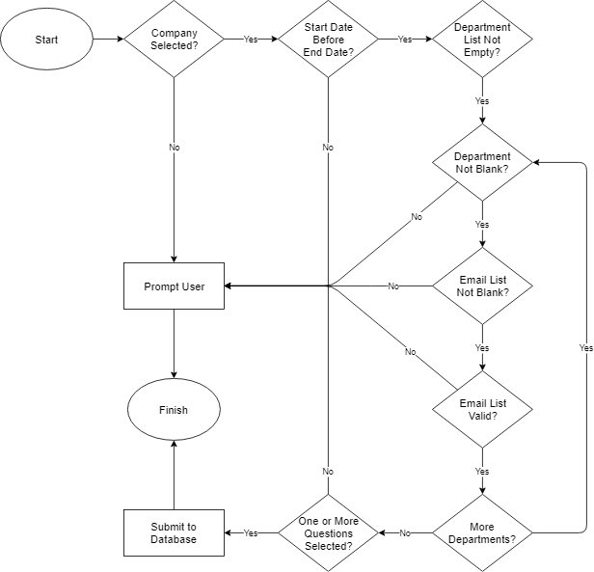
Subsystem 4: create new Survey
Data Validation Diagram:

Slide 29
Subsystem 4: create new Survey
Coding:
Languages:
HTML, CSS, PHP, JavaScript
Frameworks:
jQuery, AJAX
Testing:
Functional Testing:
Ensure that the data validation catches the necessary errors.
Ensure that the data is properly submitted to the database.
Usability Testing:
Get input from a prospective client.
System Testing:
Ensure that the subsystem functions on various platforms:
Chrome, Firefox, Edge (IE not supported)

Slide 30
Subsystem 4: create new Survey
Sprint Backlog:
Sprint | Issue # | Item | Complexity | Complete?
4 | 13 | Implement User Interface | 3 | Yes
4 | 12 | Implement Data Handling | 5 | Yes
4 | 19 | Implement Department Functions | 3 | Yes
5 | 29 | Implement Question Selection Functionality | 5 | Yes
5 | 31 | Validate User Input & Selections | 3 | Yes
5 | 30 | Submit New Survey to Database | 5 | Yes
5 | 14 | Generate Automated Emails | 3 | Yes

Slide 31
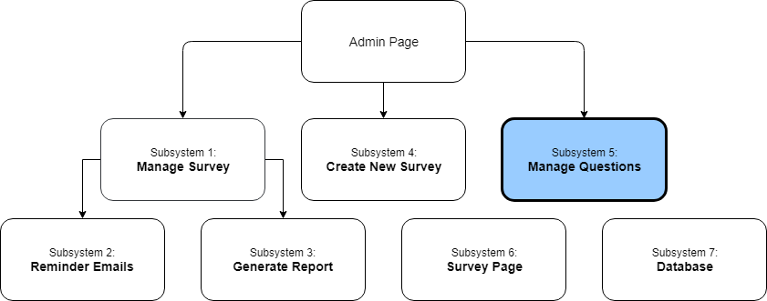
Subsystems

Slide 32
Subsystem 5: Manage Questions
Requirements:
User must be able to:
Edit question statements
Should also be able to edit a question’s ID number
Delete question statements
Add new question statements
Subsystem cannot accept any submissions using a question ID that is already linked to an existing question set
Design Choices:

Slide 33
Subsystem 5: Manage Questions
Design Choices:
Subsystem has two major parts
Adminquestion.php: This file is responsible for the initial question table layout and handles client-side page management.
Querydatabase.php: This file is responsible for establishing a connection to the database and passing an SQL query to the server. Adminquestion.php will use this file as a URL when sending or retrieving data to the database.
Questions within the table are able to be sorted by question ID number, or by alphabetical order when referring to the left or right statements.

Slide 34
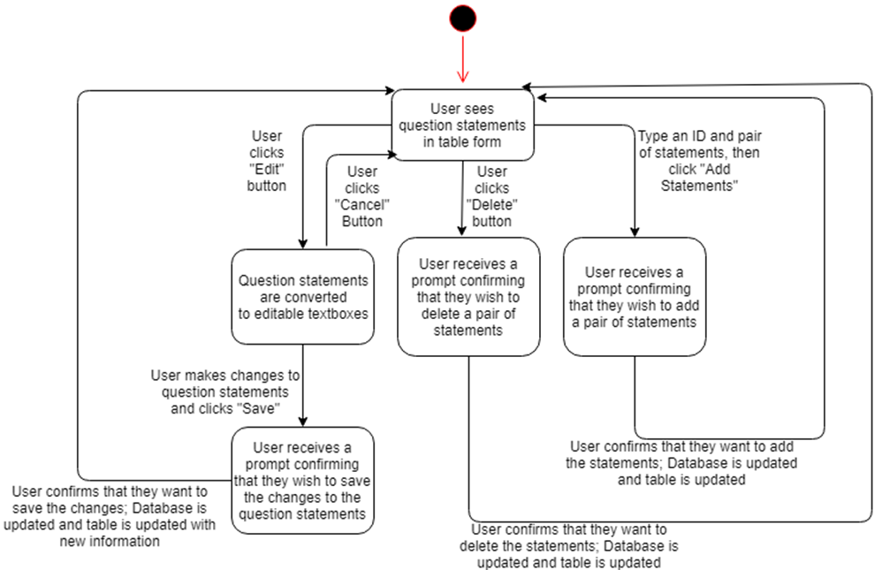
Subsystem 5: Manage Questions
State Diagram:

Slide 35
Subsystem 5: Manage Questions
Coding:
Languages:
HTML, CSS, PHP, JavaScript
Frameworks:
jQuery, AJAX
Testing:
Functionality Testing:
Confirm that table buttons work as intended
Confirm that data is properly submitted to the database
Confirm that invalid data is caught and the user is informed
Usability/Ease of Use:
Get feedback from potential client or another user not from this class
Platforms:
Must be functional on Chrome, Firefox and Edge (IE not supported)

Slide 36
Subsystem 5: Manage Questions
Sprint Backlog:
Sprint | Issue # | Item | Complexity | Complete?
2 | #18 | Generate Questions Table | 2 | Yes
2 | #36 | Generate Graphical View | 2 | Yes
2 | #26 | Implement Edit View | 2 | Yes
5 | #27 | Implement Data Management | 3 | Yes
Collaboration:
Andreas
Helped resolve my problems with understanding the client-server communication aspect of my subsystem (AJAX)

Slide 37
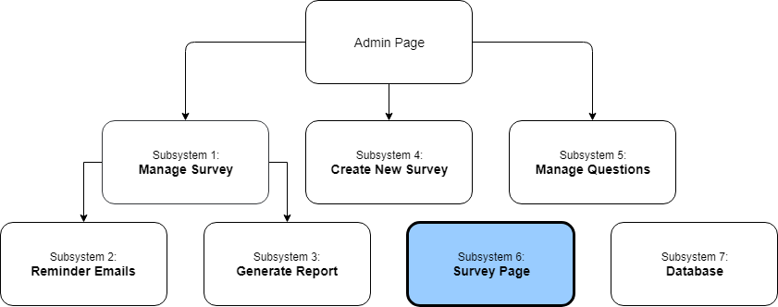
Subsystems

Slide 38
Subsystem 6: Survey Page
Requirements:
The user should be presented with Semantic Differential Questions (left statement, right statement).
The user should be able to chose from a range of responses on a Likert Scale (agree, neutral, disagree)
The user must chose a response to each question before they can submit the survey.
Design Choices:
The survey page submits responses by posting the data back to itself for evaluation and submission to the database.
The survey page uses a static header.

Slide 39
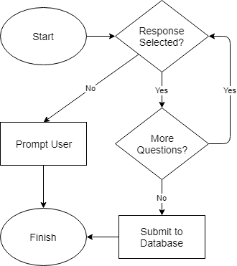
Subsystem 6: Survey Page
Data Validation Diagram:

Slide 40
Subsystem 6: Survey Page
Coding:
Languages:
HTML, CSS, PHP, JavaScript
Testing:
Functional Testing:
Ensure that the survey page generates correctly.
Ensure that the survey page submits data correctly.
Usability Testing:
Get input from a prospective client.
System Testing:
Ensure that the subsystem functions on various platforms:
Chrome, Firefox, Edge, Internet Explorer (latest versions)

Slide 41
Subsystem 6: Survey Page
Sprint Backlog:
Sprint | Issue # | Item | Complexity | Complete?
2 | 3 | Confirm Participant ID in Hyperlink | 2 | Yes
2 | 4 | Generate Survey Table | 2 | Yes
2 | 5 | Generate Survey Graphical Controls | 2 | Yes
3 | 6 | Validate User Input | 3 | Yes
3 | 7 | Submit Survey to Database | 3 | Yes

Slide 42
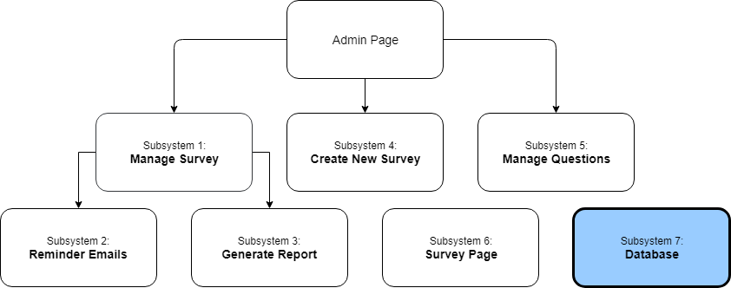
Subsystems

Slide 43
Subsystem 7: database
Requirements:
The Survey System requires a MySQL database.
Design Choices:
The following relationships are maintained:
[1] Company --- [0..*] Survey
[1] Survey --- [0..*] Department
[1] Survey --- [0..*] SurveyQuestion (XREF)
[1] Department --- [0..*] Participant
[1] Department --- [0..*] Response
[1] Question --- [0..*] Response
[1] Question --- [0..*] SurveyQuestion (XREF)
The relationships maintain Cascade Update & Delete.

Slide 44
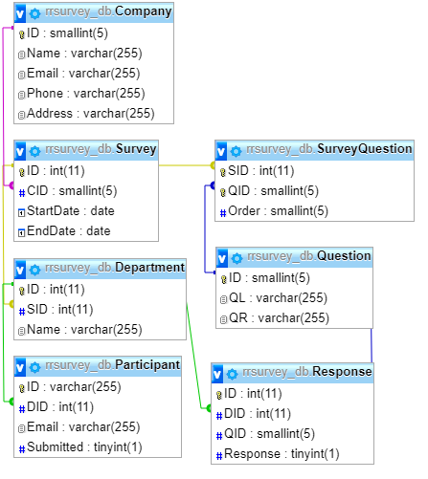
Subsystem 7: database
Entity Relationship
Diagram:

Slide 45
Subsystem 7: database
Data Dictionary:
Company:
ID (SMALLINT) – Auto Increment ID
Name (VARCHAR) – Name of the company
Email (VARCHAR) – Email of company contact
Phone (VARCHAR) – Phone number of contact
Address (VARCHAR) – Address of the company
Survey:
ID (INT) – Auto Increment ID
CID (SMALLINT) – Company ID (one company, many surveys)
StartDate (DATE) – The start date for the survey
EndDate (DATE) – The end date for the survey

Slide 46
Subsystem 7: database
Data Dictionary (continue):
Department:
ID (INT) – Auto Increment ID
SID (INT) – Survey ID (one survey, many departments)
Name (VARCHAR) – Name of the company
Participant:
ID (VARCHAR) – Generated string of 100 characters
DID (INT) – Department ID (one department, many participants)
Email (VARCHAR) – The participant’s email
Submitted (TINYINT) – Indicated submission status (boolean)

Slide 47
Subsystem 7: database
Data Dictionary (continue):
Question:
ID (SMALLINT) – Configurable Question ID
QL (VARCHAR) – Left statement
QR (VARCHAR) – Right statement
SurveyQuestion (XREF Table):
SID (INT) – Survey ID (one survey, many question choices)
QID (INT) – Question ID (one question, many times chosen)
Order (SMALLINT) – The order of the question in the survey
Response:
ID (INT) – Auto Increment ID
DID (INT) – Department ID (one department, many responses)
QID (SMALLINT) – Question ID (one question, many responses)
Response (TINYINT) – Participant response (1-6)

Slide 48
Subsystem 7: database
Coding:
Language:
SQL
Testing:
Stress Testing:
Insert large amounts of data and see how the database performs.

Slide 49
Subsystem 7: database
Sprint Backlog:
Sprint | Issue # | Item | Complexity | Complete?
1 | 1 | Prepare CREATE TABLE SQL Scripts | 2 | Yes
1 | 2 | Implement Tables | 1 | Yes

